Slide 1
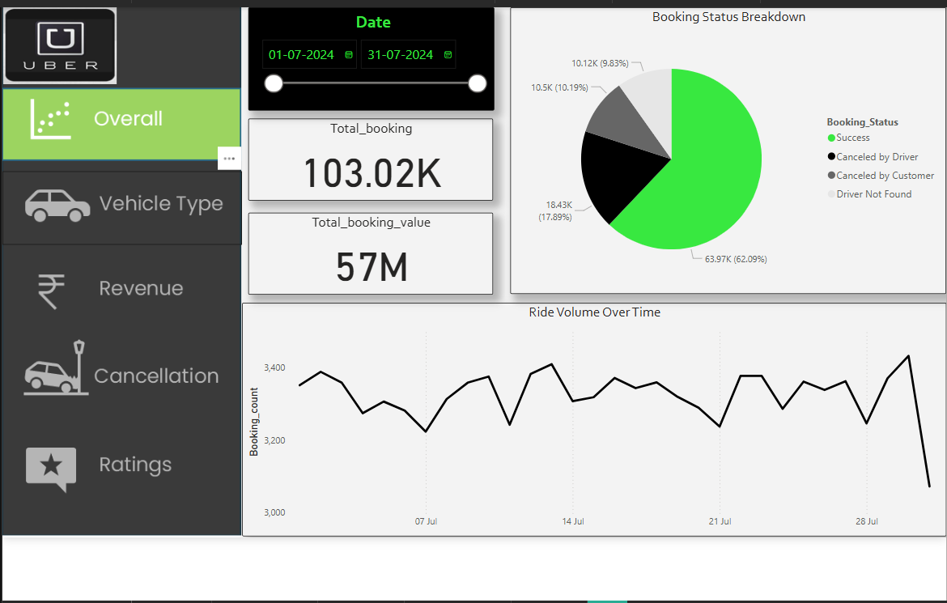
Title: *Ride-Sharing Performance Report – July 2024*
Strong Demand, But Conversion Challenges
103K bookings generated ₹57M revenue, but 28% were cancellations (38% of potential revenue lost).
Driver Availability Issues
"Driver Not Found" in 8.83% of cases (10.12K bookings) – indicates dispatch system or supply gaps.
Cancellation Breakdown
Customer cancellations (10.5K) likely due to wait times/pricing.
Driver cancellations (18.4K) suggest operational/payment issues

Slide 2
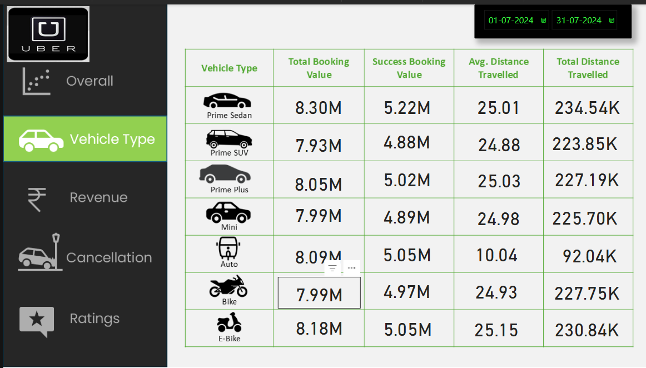
1. Prime Vehicles Dominate Revenue
Prime Sedan & SUV generate ₹8.3M+ each in booking value.
Success rates are high (₹7.93M for Sedan, ₹7.99M for SUV), indicating premium service reliability.
2. Distance Metrics Reveal Usage Patterns
Avg. distance: ~25 km/trip for Prime vehicles → Longer, high-value rides.
Total distance: 234K km (Sedan) vs. 230K km (SUV) → Sedans slightly more utilized.
3. Revenue Leak in Cancellations
Data suggests cancellations for Mini, Auto, Bike, E-Bike (values not shown but implied).
Opportunity: Investigate why non-Prime vehicles underperform.

Slide 3
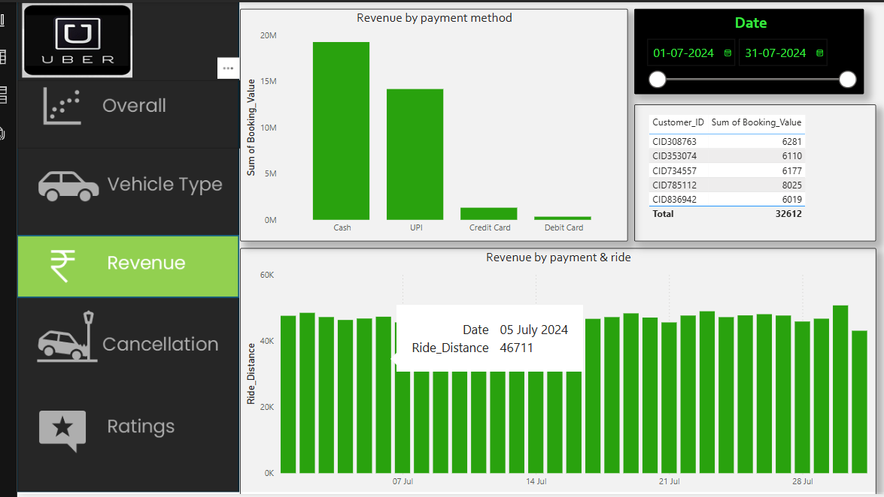
Top Customers Drive Significant Value
Top 5 customers generated ₹32,612 in total bookings
Highest-value customer (CID785112) contributed ₹8,025 alone → Potential VIP program candidates
2.Weekly Revenue Patterns
Data captured for key dates (7 Jul, 14 Jul, 21 Jul, 28 Jul)
Action: Compare with cancellation data to identify most profitable days

Slide 4
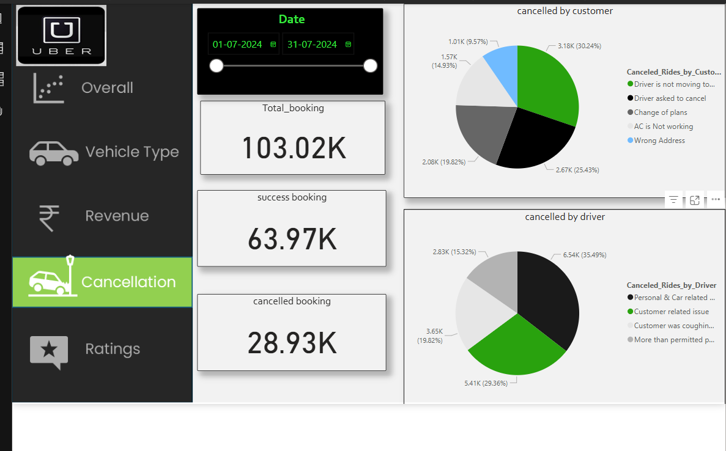
Key Cancellation Insights
Alarming Cancellation Rates
28.93K cancellations (28% of total bookings)
Nearly 1 in 3 bookings lost → Significant revenue leakage
Customer-Side Cancellations (30.24% Peak)
Top Reasons:
Wrong Address (25.43%)
AC Not Working (19.82%)
Driver Not Moving (9.57%)
Pattern: Mostly service quality issues
Driver-Side Cancellations (35.49% Peak)
Primary Causes:
Customer-Related Issues (35.49%)
Personal/Car Problems (23.36%)
Red Flag: "Customer was coughing" suggests health/safety concerns

Slide 5
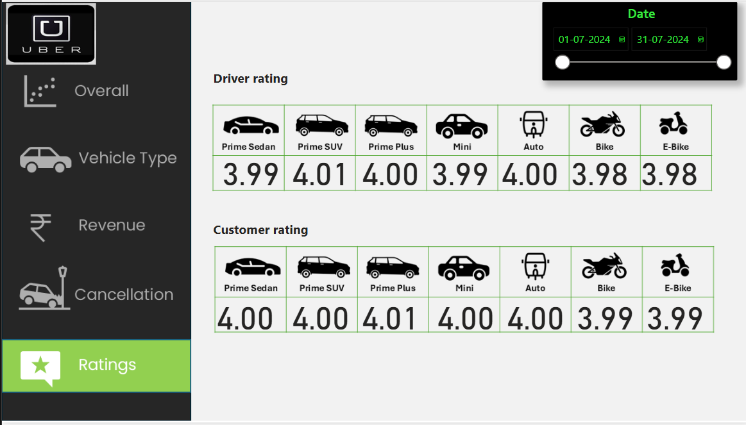
Service Quality Insights
Consistently High Ratings Across Fleet
All vehicle types maintain ratings between 3.98-4.01 (out of 5)
Indicates generally satisfactory service quality
Premium Vehicles Lead Performance
Prime SUV (4.01) and Prime Plus (4.00) show highest driver ratings
Prime Sedan and SUV both achieve perfect 4.00 customer ratings
Bike/E-Bike Segment Shows Slight Gap
Lowest ratings in both categories (3.98 driver, 3.99 customer)
Suggests minor quality/comfort issues in two-wheeler segment

